Slide 1
Course Instruction and Introduction
Chapter 0 – Hands on Data Analytics for Everyone
北京师范大学-香港浸会大学联合国际学院
United International College

Slide 2
Welcome to Hands on Data Analytics for Everyone
Notes:
Instructors: Take time, to add a welcome message.

Slide 3
Session 1002: Contact
Instructor: Dr. Donglong Chen
Office T3-401-R4
donglongchen@uic.edu.cn
Appointment is needed for office hours Q&A. Timetable: https://staff.uic.edu.cn/donglongchen/cn
Teaching Assistant: Mr. Zhenxuan Liang
Office T6-403-H2
Email: zhenxuanliang@uic.edu.cn
Both instructor and teaching assistant are available to answer questions on WeChat. Do use:
WeChat
Office hours / Tutorials
Before and after class (5 minutes)
Email

Slide 4
Tutorials (Assistant Instructor)
Time & Venue
Repeated twice a week between weeks 3 (19 Sept) – week 12 (2 Dec), excluding the reading week 7
Tuesday TBA
Friday TBA
Rules / Contents
Student attendance is optional
Tutorials partially cover the contents of the main lecture / lab (previous week)
Communication during the tutorials can be in Chinese or English
Students are expected to actively practice and review contents from previous lectures
Students can ask questions
The assistant instructor will not help students to do their homework

Slide 5
How to Ask for Questions
WeChat group
You are highly encouraged to come to instructor office hours and TA tutorials for questions
For short inquiries, email directly. You can expect a reply in about 24h. Email is the official channel of communication, so use a formal language. Unclear messages will not receive an answer. You can use the following template:
Subject: [Hands on Data] Inquiry about ...
Email body:
Dear Dr. Chen,
This is Sun Yan from your "Hands on Data" Session 1002. I have a question regarding […].
Can you advise?
Regards,
Yan

Slide 6
Course Organization: Grading
6 assignments with deadline on the next Wednesday of almost every week, submission on iSpace
Content of assignment is the same or similar to the lab of the same week
Each assignment have its own grading weight
Submission delay: 24h (20% penalty), 48h (40% penalty), >48h (no acceptance)
Assignments
30%
The participation consists of
Class Attendance
Activeness / answer to bonus questions
Participation
10%
Group Size: 3 to 4 members
Group Work Timing:
Form groups (as soon as possible) and do preliminary work by week 8
Carry the project work in week 11 – 12 and submit the presentation slides by week 12
Present the project in weeks 13-14
Group Project
30%
Written examination: General questions in data science, multiple choices and short exercises (fill missing expressions, possible math computations)
Exam duration: 2 hours in December 20-31 (week 16-17)
It is compulsory and need to reach at a minimum threshold in order to pass the course (otherwise the student will receive a F grade, irrespectively of the marks for the other assessment components)
Final Exam
30%

Slide 7
Policies
Late submission
For assignments and project, 20% penalty for up to 24h delay, 40% penalty for up to 48h delay, no late submission will be accepted after 48h
Academic honesty
Copying from others, or allowing others to copy from you, is considered academic plagiarism.
Student conflict / group project :
The grade for the group project will be assigned individually to each member of the group but within a band
Group members who do not participate in the group work or fail to present the project will receive 0 grade
Stronger members of the group shall help weaker members to learn during the project work
Group members shall try to solve any conflict by themselves before asking the course instructor to mediate

Slide 8

How To Fail This Course
If you want to fail this course do the following:
Play with your phone in class ( → 10%)
Do not come for class (→ 20%)
Do not do difficult assignments (→ 30%)
Do not submit your project (→ 50%)
Do not prepare for exam (→ 70%)
Copy the exam (→ 100%)

Slide 9
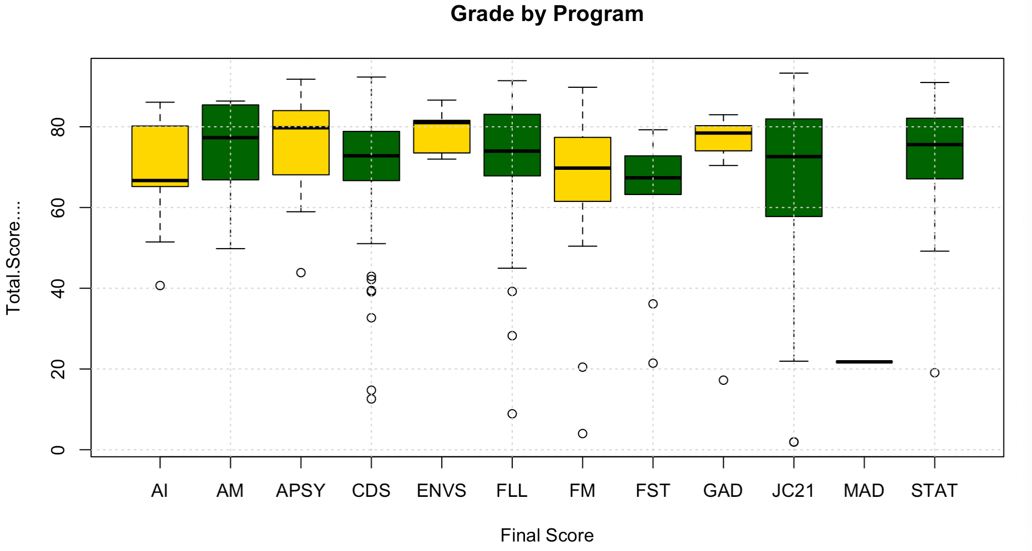
Last Year Student Performance

Slide 10
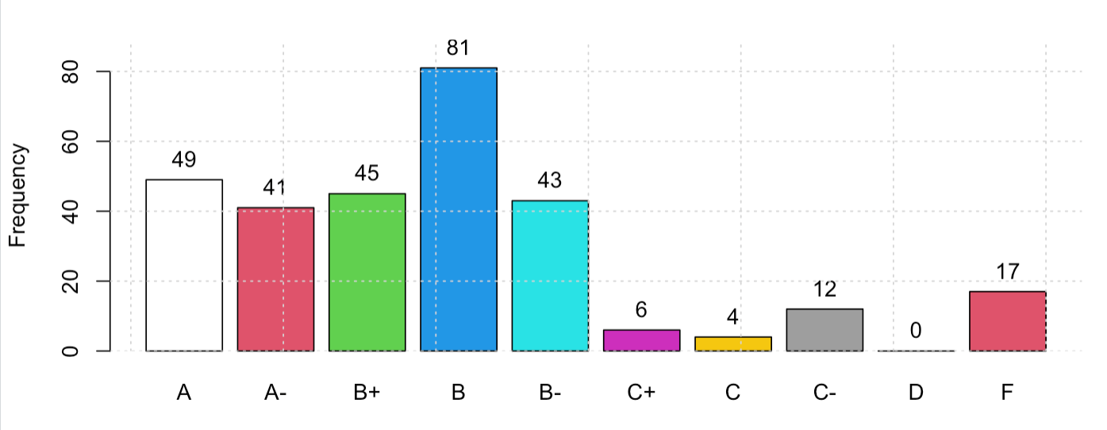
Last Year Student Performance

Slide 11
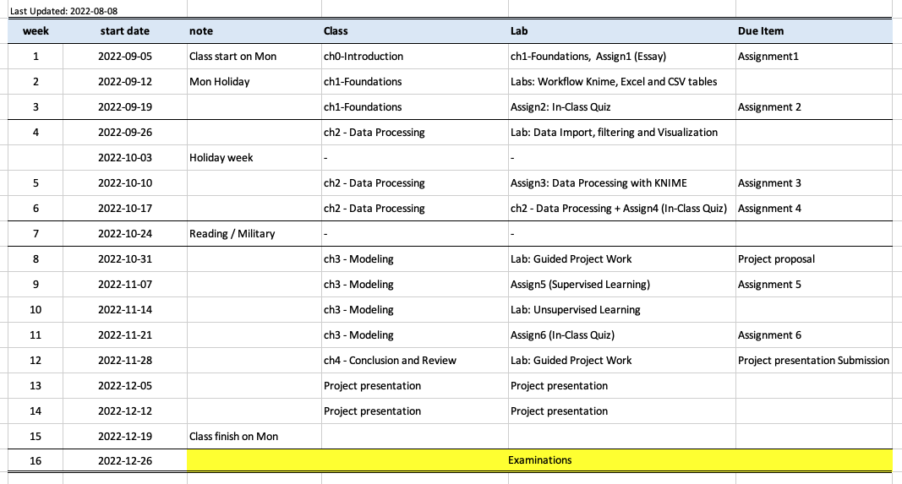
Course Plan (Subject to Revision)

Slide 12
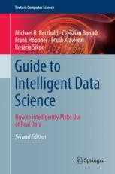
References
Lecture Notes
Check iSpace regularly for updates
Book:
Berthold, M.R., Borgelt, C., Höppner, F., Klawonn, F., Silipo, R. (2020), “Guide to Intelligent Data Science” , Springler, chapters 1-8

Slide 13
What is Data Analytics?

Slide 14
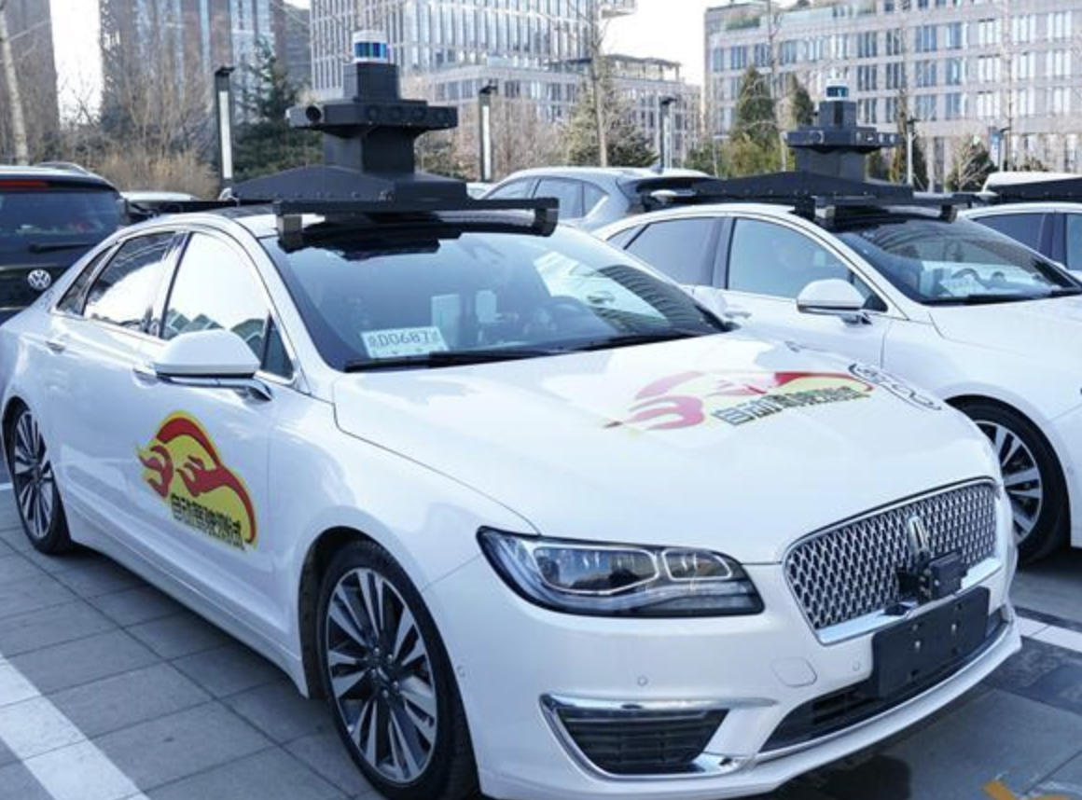
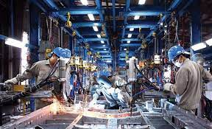
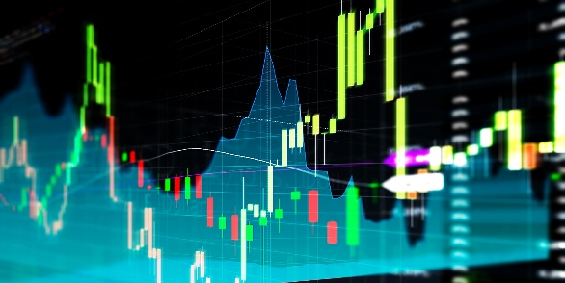
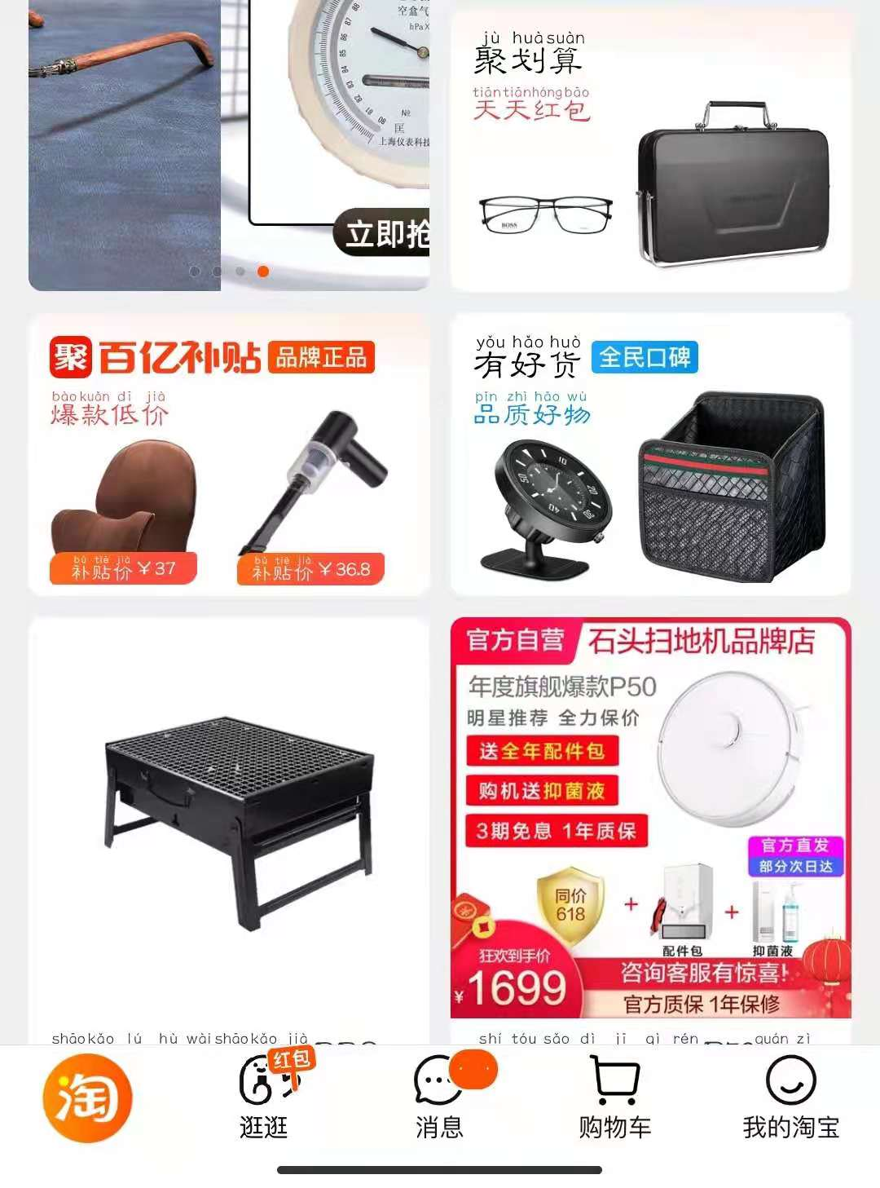
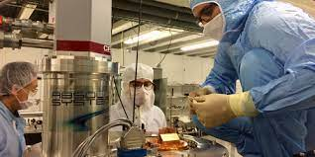
Which of the Following Make Use of Data Analytics?
Autonomous Driving Car
Industrial Production
Investment in Financial Markets
Taobao (淘宝）
Scientific Research

Slide 15
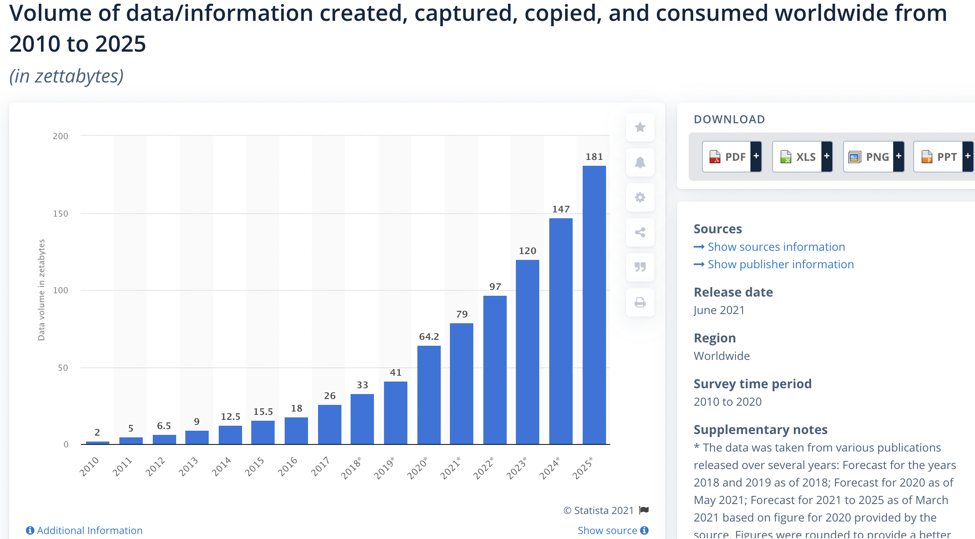
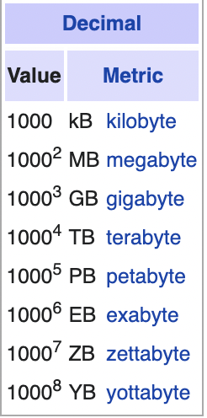
Data is Everywhere. Can you make use if it?

Slide 16
Data Science Skills
Database, Coding Skills
Math, Statistics, Machine Learning Knowledge
Machine Learning Researcher
Domain / Business Expertise
“All round” Data Scientist
Data Engineer
Data Analyst
Business Analyst

